Slide 1
BUSINESS REPORT
SALES GROWTH

Slide 2
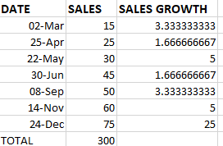
INTRODUCTION TO THE SALES ANALYSIS:
Sales Growth’s formula:
(Previous-present)/total *100.

Slide 3
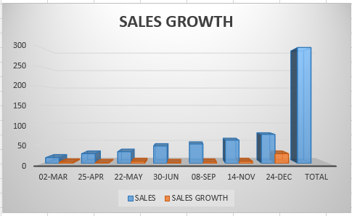
Inserted bar chart from Excel:

Slide 4
Key findings and recommendations:
Increase the quality of products.
Make people more familiar to it.
Advertising it on TV.
Teach the workers how to treat people.

